Slide 1
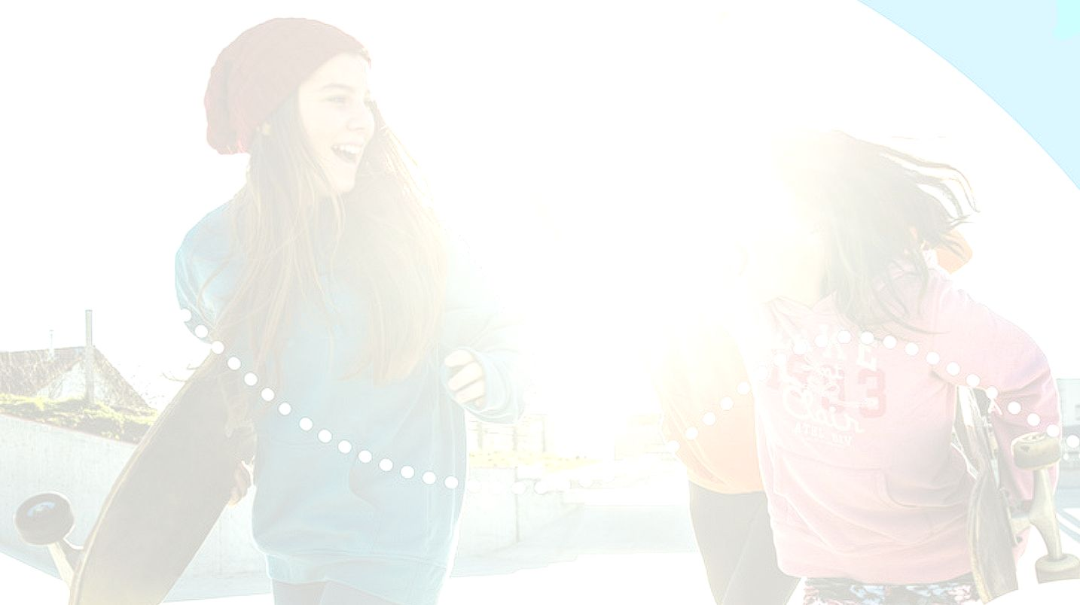


UNIT 4;
Every man is an artist
Self-check 4

Slide 2
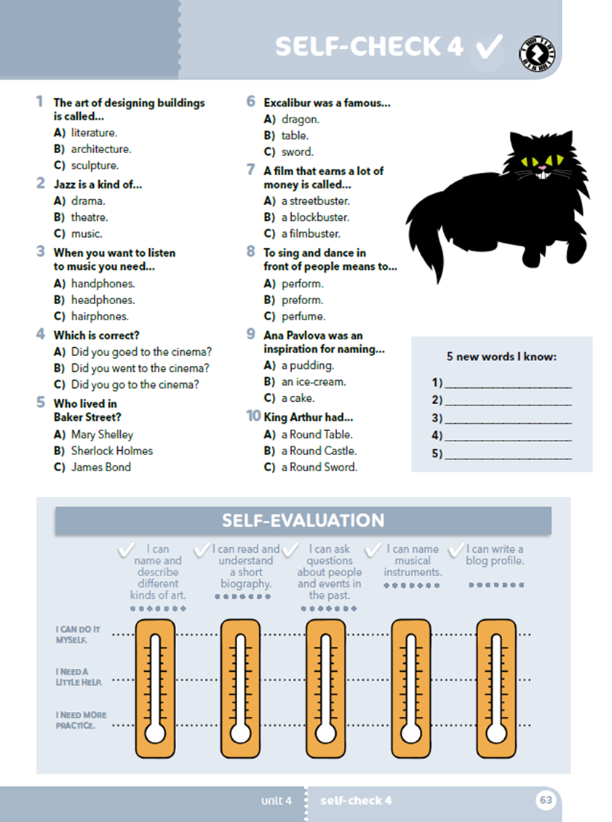
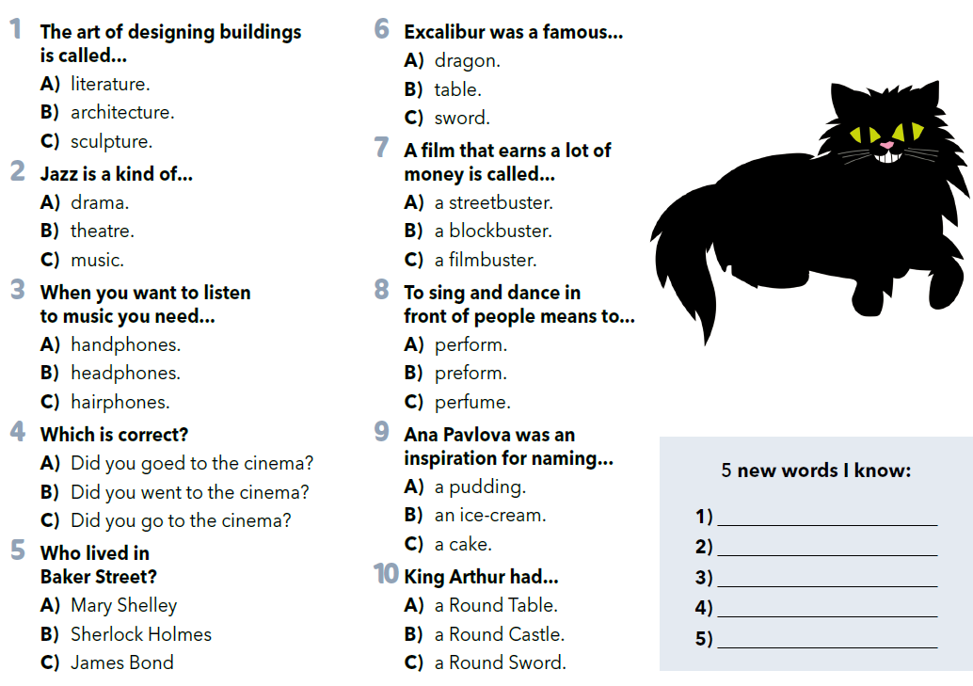


Read the questions and circle the correct answer.
Write 5 new words you know.
Practise:
https://wordwall.net/play/903/098/542
https://create.kahoot.it/share/footsteps-2-unit-4-self-check/92358392-4eb0-46f2-adc3-17c820028d10?fbclid=IwAR12pYHTeH5ovr5pQ0eQq7sZW-EhcxQoV0JeZmuoKUsK6-XGaFumcDIm8Cc

Slide 3
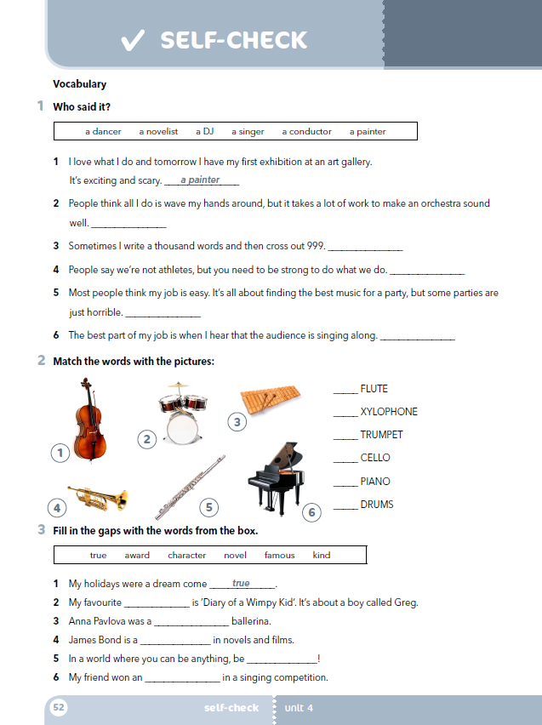
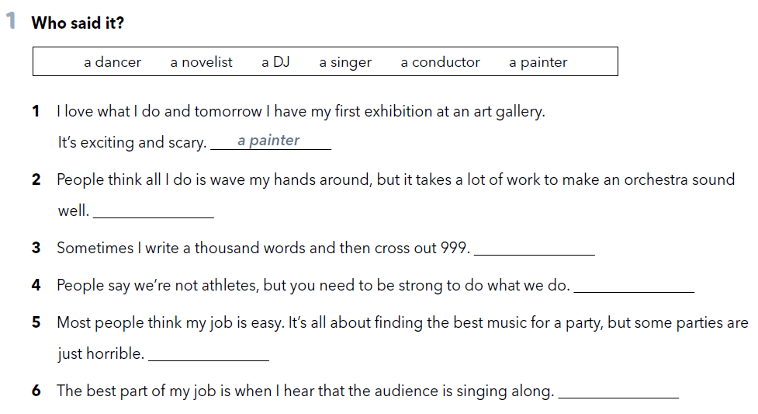
Workbook, p. 52
a conductor
a novelist
a dancer
a DJ
a singer

Slide 4
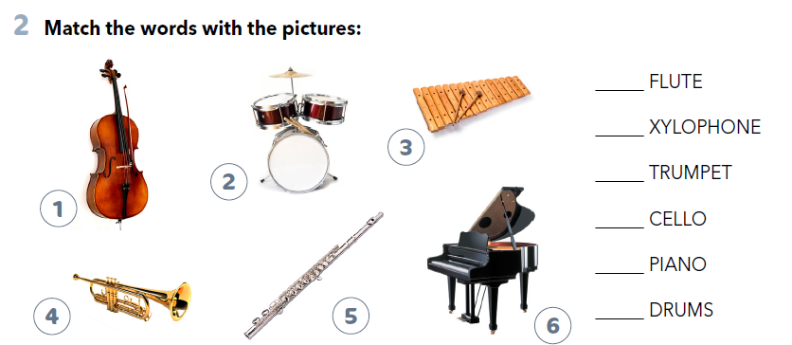
5
3
4
1
6
2

Slide 5
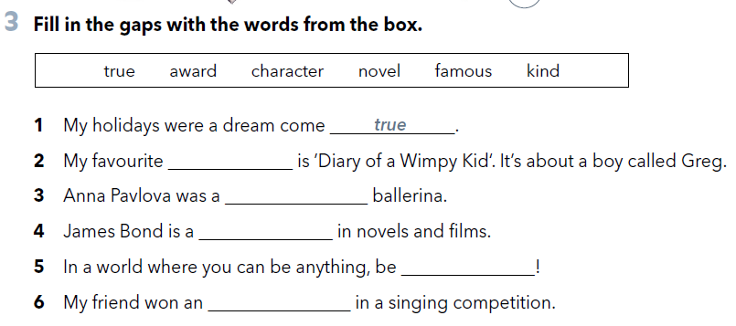
novel
famous
character
kind
award

Slide 6
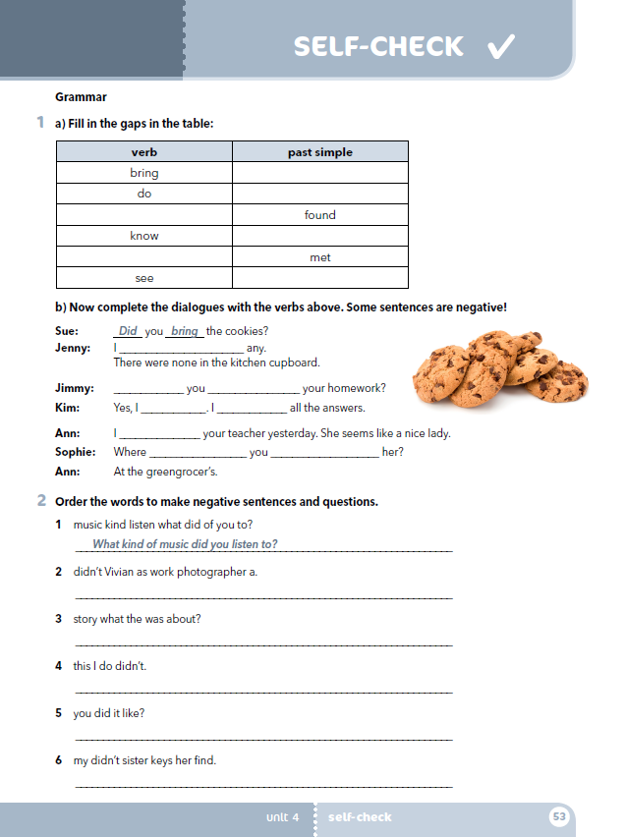
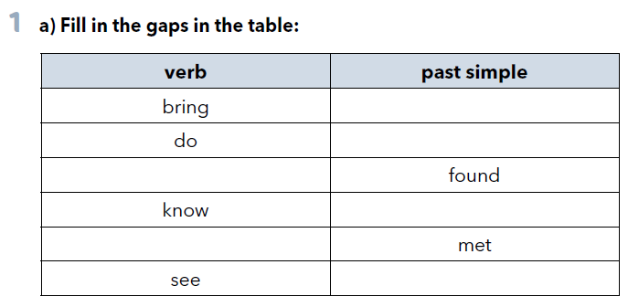
In task 1a, page 53, you have to choose the correct option.
brought
did
find
knew
meet
saw

Slide 7
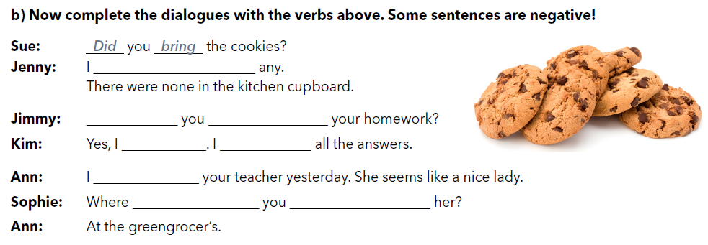
didn’t find
Did do
did
knew
met
did see

Slide 8
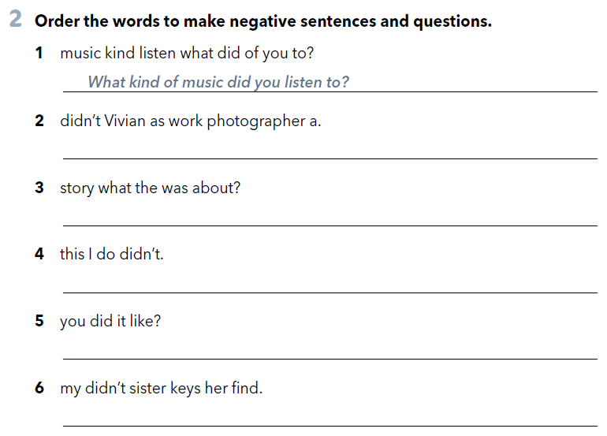
Vivian didn’t work as a photographer.
What was the story about?
I didn’t do this.
Did you like it?
My sister didn’t find her keys.

Slide 9
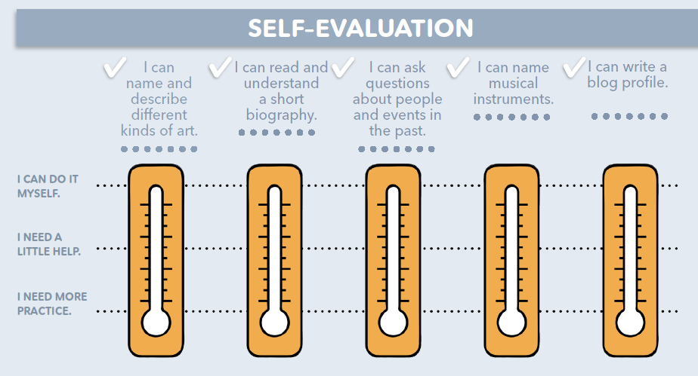
mogu sam, jasno mi je
trebam malo pomoći
moram još vježbati

